Slide 1
I Have Nothing More to Give
The Wise Still Seek Him Today
© June, 2001

Slide 2
I Have Nothing More to Give
The Rev. Mrs. Dr. Carolyn Cole, Retired
Christian
Spiritual Director/Retreat Master/Bible Teacher
© May, 2001

Slide 3
The Good Shepherd Ministry Psalm 23
Walking in Wholeness and Holiness

Slide 4
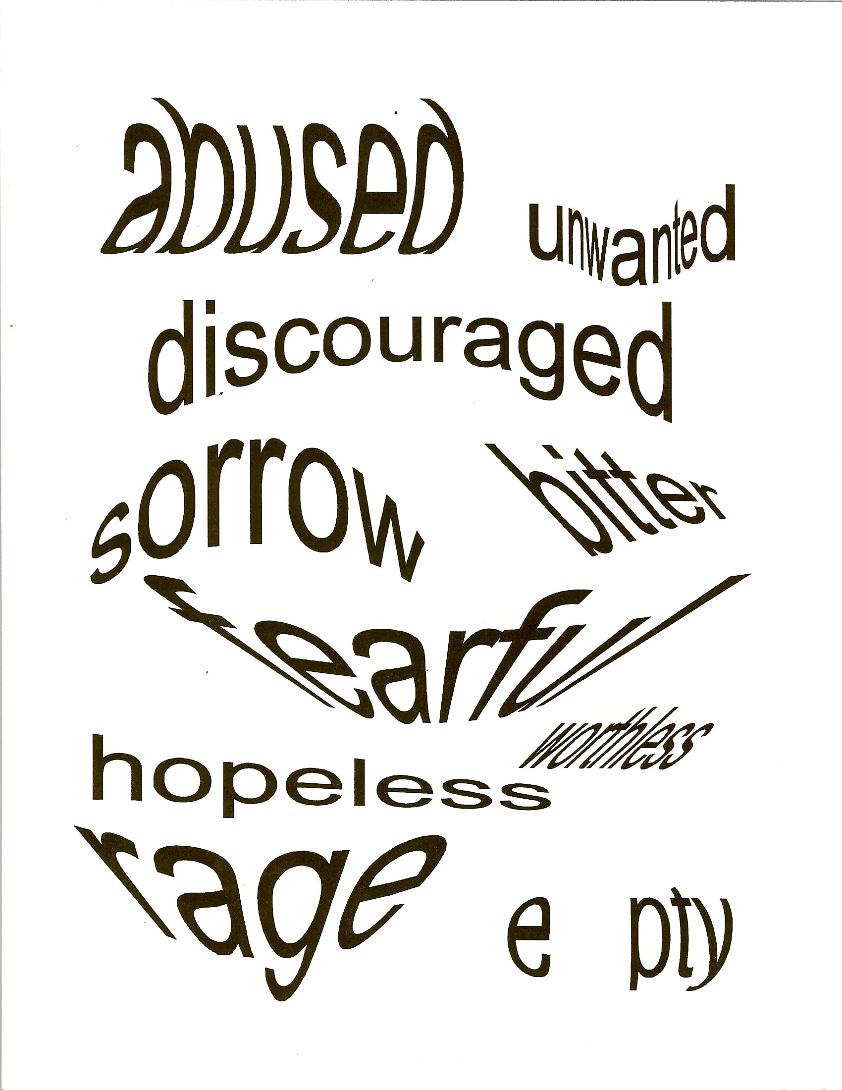

Slide 5


Slide 6

lost
J O Y
Grief
Lonely
ANGER
Guilt
unloved
Rejected
Happy
Broken
Sad
abandoned

Slide 7
lost
J O Y
Grief
Lonely
ANGER
Guilt
unloved
Rejected
Grief
Pain Anger
Rejection
Lonely
unwanted
Happy
Broken
Sad
abandoned

Slide 8
Love
Joy
Peace
Long-Suffering
Gentleness
Goodness
Faith
Meekness
Temperance

Slide 9
Love
Joy
Peace
Long-Suffering
Gentleness
Goodness
Faith
Meekness
Temperance
fearful
King David
St. Paul
Helpless
ANGRY
Sorrow
useless
John the Baptizer
discouraged
Jeremiah
Abused
Mary
Lost
USED
Job
Miriam
Rejected
Depressed
The People of the Way

Slide 10
What
feeling words
fill
your
Life?
Draw your glass-flask.

Slide 11
What
feeling words
fill
your
Life?
Draw your glass-flask.
sad
bitter Anger
abandoned
lost
useless

Slide 12
What
feeling words
fill
your
Life?
Draw your glass-flask.
Angry
sad
Abandonment
Empty
forgotten
bitter
lonely

Slide 13
I Have Nothing More to Give
Spirituality: The Journey of a Life-Time
1. This is an integration of clinical, theological, and spiritual disciplines.
It has been said that when an inner situation is not made conscious, it happens outside as fate.

Slide 14
I Have Nothing More to Give
This workshop is designed to lead Christians, in the context of a military setting, to discover and acknowledge that they are on a personal journey of healing and liberation, and maturing in wholeness and holiness as they, in turn, participate in the healing and liberating of others.

Slide 15
I Have Nothing More to Give continued
3. My interest is in helping Christians to be real about their faith and feelings instead of believing they are supposed to act like everything is wonderful – when the Bible does not teach this falseness.

Slide 16
I Have Nothing More to Give continued
This retreat is designed to open the hearts of those who involve themselves in this journey, believing it will awaken them to a deeper understanding of walking in wholeness and holiness. This is done as participants ask questions such as,

Slide 17
I Have Nothing More to Give continued
“What did the saints of God in the Bible feel? Do I have anything in common with them, any feelings in common with them? What would it be like to walk with one of them?

Slide 18
I Have Nothing More to Give continued
Were they ever told, ‘Nice boys and girls don’t get angry,’ or ‘Big boys and girls don’t cry’? Were they ever told, ‘Don’t feel, don’t trust, and don’t talk’”?

Slide 19
I Have Nothing More to Give continued
Feelings are God-given, and it is important that they be reflected upon in light of walking The Way, understanding that they, the participants, are a part of the whole people of God, walking in wholeness and holiness in the midst of the uncomfortableness of these feelings.

Slide 20
I Have Nothing More to Give continued
It is important to recognize that the saints, the great cloud of witness, experienced uncomfortable feelings as they were walking The Way.

Slide 21
I Have Nothing More to Give continued
The intent of this presentation is to awaken, identify, and acknowledge faith and feelings that may be lying dormant and to acknowledge the calling of each to walk in wholeness and holiness with integrity, being able to know the Christian life is a journey to which each is called in light of who each one is within the context of the body of Christ.

Slide 22
I Have Nothing More to Give continued
We are created mind, body, and soul. Three segments are as follows:

Slide 23
I Have Nothing More to Give continued
1. Filling the glass flask of life with feeling words, using those words on a time-line
2. Working with Feelings/Facts/Faith and how they come together or do they

Slide 24
I Have Nothing More to Give continued
3. Journaling, being in touch with one’s feelings with pen, writing letters to different people whom the participant would like to give a “piece of his/her mind” – to include God, and doing the spirituality time-line

Slide 25
I Have Nothing More to Give continued
4. This is an interactive workshop, involving the participants on their own journey – as much as they are willing to be involved.

Slide 26

Where
are your
feelings?

Slide 27
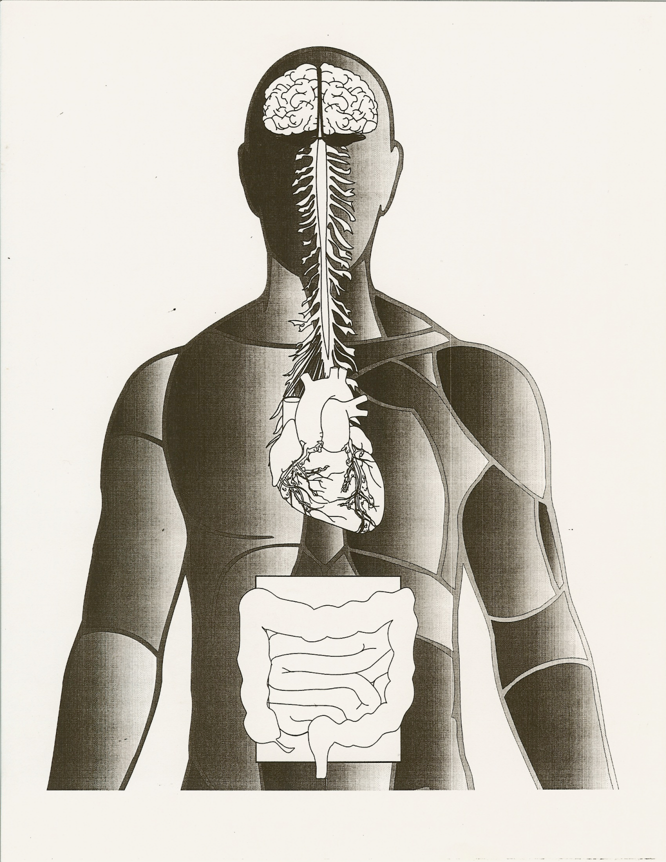

Slide 28
Mind
Heart
Gut

Slide 30
Feelings, Facts, Faith
Feelings Facts Faith

Slide 31
Feelings, Facts, Faith
Feelings Facts Faith
resentment

Slide 32
Feelings, Facts, Faith
Feelings Facts Faith
resentment
forgotten

Slide 33
Feelings, Facts, Faith
Feelings Facts Faith
resentment
forgotten
betrayed

Slide 34
Feelings, Facts, Faith
Feelings Facts Faith
resentment
Done wrong
forgotten
betrayed

Slide 35
Feelings, Facts, Faith
Feelings Facts Faith
resentment
Done wrong
forgotten
Not acknowledged
for what I did
betrayed

Slide 36
Feelings, Facts, Faith
Feelings Facts Faith
resentment
Done wrong
forgotten
Not acknowledged
for what I did
betrayed
A friend turned
against me

Slide 37
Feelings, Facts, Faith
Feelings Facts Faith
An intimate relationship with God allows us to be honest with ourselves and God with what we feel and what we think.
resentment
Done wrong
Not acknowledged
for what I did
forgotten
betrayed
A friend turned
against me

Slide 38
Feelings, Facts, Faith
Feelings Facts Faith
An intimate relationship with God allows us to be honest with ourselves and God with what we feel and what we think.
God knows our heart;
why do we not get honest and acknowledge our sIn as did Job?
resentment
Done wrong
Not acknowledged
for what I did
forgotten
betrayed
A friend turned
against me

Slide 39
Feelings, Facts, Faith
Feelings Facts Faith
An intimate relationship with God allows us to be honest with ourselves and God with what we feel and what we think.
God knows our heart;
why do we not get honest and acknowledge our sIn as did Job?
Healing will come for us as we offer ourselves to the Lord and the Balm of Gilead to others.
resentment
Done wrong
Not acknowledged
for what I did
forgotten
betrayed
A friend turned
against me

Slide 40
Day One
0900 – The Gathering
0945 – Session I: Walking with Peter
1030 – Break
1045 – Session II: Where Were You?
1200 – Lunch
1300 – Praying, Sharing, and Fellowshipping
1530 – Session III, Part A: Time-line and Feeling
Words and Glass Flask
1615 – Break
1630 – Session III, Part B: Interactive Time
1800 – Dinner

Slide 41
Day Two
0730 – Breakfast
0830 – Session IV: In prison with John the Baptizer
0930 – Session V, Part A: Fake it until you make it
1040 – Break
1100 – Session V, Part B: Stories
1200 – Session V, Part C: Physician, Heal Thyself
1300 – Lunch

Slide 42
Day Two continued (optional)
1400 – Praying with clay
1530 – Session VI: The Message and
The Blessing,
The Breaking, and
The Being Used
The Holy Communion

Slide 43
Clarification of the Process
The following are comments that may clarify each lesson. Three sessions could easily be given to each lesson, with ongoing one-on-one work during at other times.
This is deeply experiential. It is not about re-framing, reprogramming one’s thinking, nor is it about managing feelings.

Slide 44
Clarification of the Process continued
This is the understanding that it is necessary to go to the magma chamber (gut) of the volcano (one’s life) to help the person begin being aware of their need to escape, whether to drugs or religion, to relationships or to God. It is dealing with repressed feelings.

Slide 45
Clarification of the Process continued
The goal of this work is to help individuals become aware of feelings that may be lying dormant, to identify them and to acknowledge them. It is in this work that one is able to go forward seeking the Lord Jesus Christ in their lives and the healing that He alone can give.
It is about surrendering one’s life to Jesus totally and to commit to His way, a life of holiness.

Slide 46
Clarification of the Process continued
The purpose is to help chaplains specifically become healers who touch other people’s lives in a positive way.

Slide 47
Clarification of the Process continued
There are people who have taken long-term as well as short-term substance abuse classes who have said in this class, “Why hasn’t someone helped us with this before? All we have had is someone trying to reprogram our minds. We’ve never understood where our behavior is coming from and why we, as individuals, do what we do.” There are many tears shared in this type of work. Worth it all!

Slide 48
Clarification of the Process continued
The following in no way does justice as to what actually takes place in the classes. This is not philosophizing or asking “What do you think?” “And, what do you think?” This is getting to the core of the matter and working individually within the group as well as the group working on issues in their lives that they have repressed. There is much more to the classes than is in the lesson explanations.

Slide 49
Clarification of the Process continued
This work is an integration of the clinical, theological, and spiritual disciplines: practical Christianity.
What is done is not set in stone as the Holy Spirit guides in what He desires to do in people’s lives.

Slide 50
Clarification of the Process continued
Thank you for taking time to peruse this material for possible consideration for the Chaplains, the healers, for the benefit of all who want to change and make a difference in their lives, thus reaching out to make a difference in the lives of their families and beyond: The pebble that is thrown into the water ripples out to the world in a way that only Jesus through the Holy Spirit can do.

Slide 51
I Have Nothing More to Give
Purpose:
To open a window through which participants might be able to recognize some of their feelings, and to experience life as mind, body and soul: an integration of the clinical, theological, and spiritual disciplines.

Slide 52
I Have Nothing More to Give
Goal:
To help participants begin a journey of awakening feelings that each of us have, that may be lying dormant, to become aware of those feelings, to identify those feelings, and to acknowledge them.

Slide 53
Take time
to be bathed
in prayer

Slide 54
by the
People of God

Slide 55
Practice the Presence
of God

